Slide 1
Functioning in the 3.0 Era of Healthcare
Sean G. Boynes, DMD, MS
Director of Interprofessional Practice
DentaQuest Institute

Slide 2
2
Notes:
In 2011 the Congressional Budget Office projected health care costs as the single largest threat to the federal budget
The Health Care System
Is too expensive, threatens the economy
Does not achieve the best health for the money

Slide 3
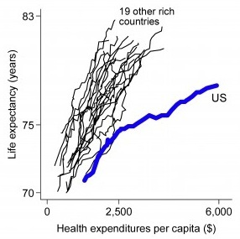
Life Expectancy by Health Expenditures per Capita, 1970-2008
The data points are years. Health expenditures are total (public and private), in inflation-adjusted PPP-converted US dollars, at t-5. The other countries are Australia, Austria, Belgium, Canada, Denmark, Finland, France, Germany, Ireland, Italy, Japan, the Netherlands, New Zealand, Norway, Portugal, Spain, Sweden, Switzerland, and the United States. Data source: OECD
http://lanekenworthy.net/2011/07/10/americas-inefficient-health-care-system-another-look/
Notes:
And what are we getting for the money??? And what are we going to do about it?????

Slide 4
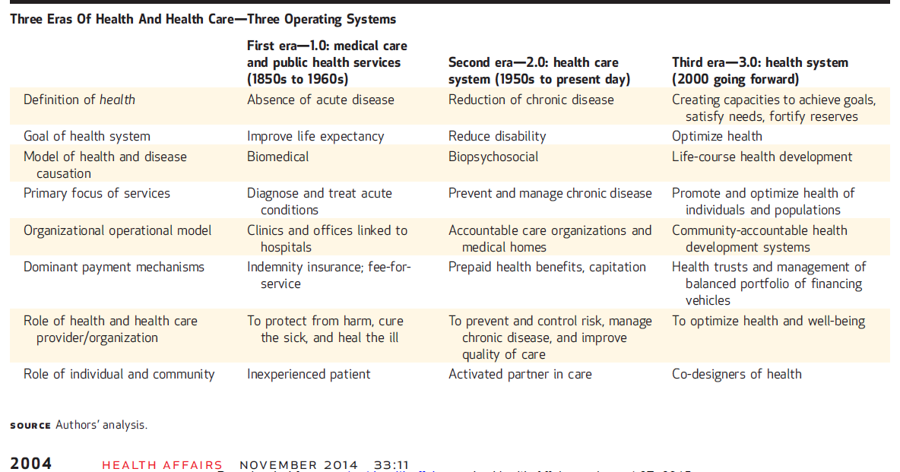
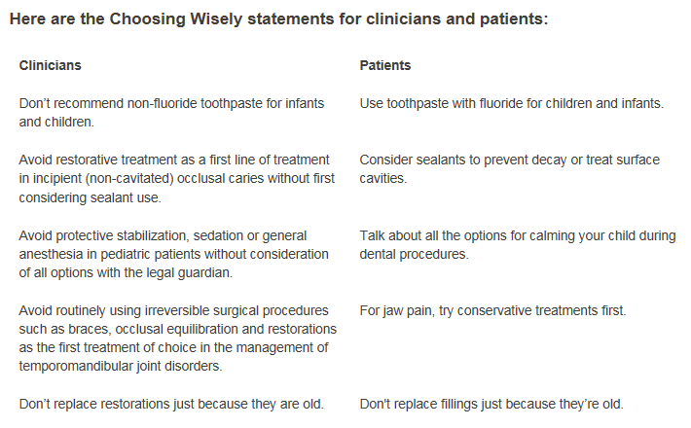

Slide 6
-Dr. Don Berwick, IHI [NOSORH Annual Session 2016]
Notes:
In doing this transition start to see a heavier lean into disease management and prevention (this should lead into the MEPS data)

Slide 7
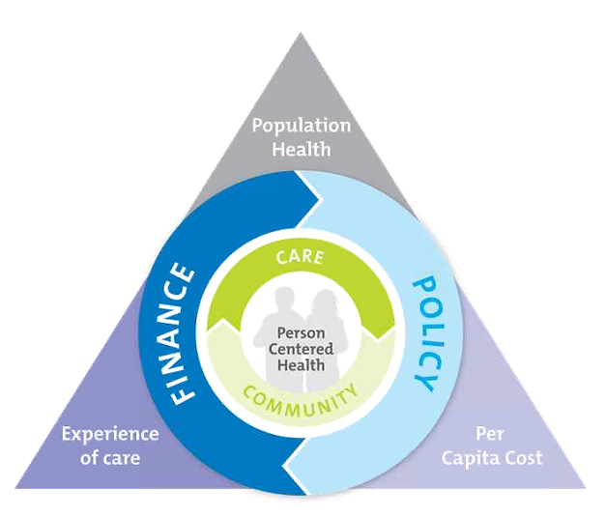
Triple/Quadruple Aim
Notes:
Why should they care

Slide 8
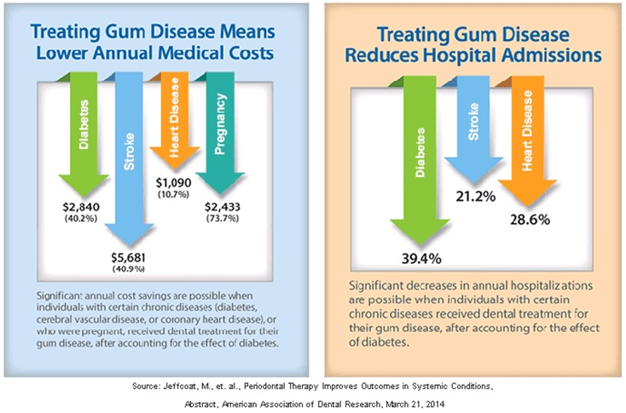
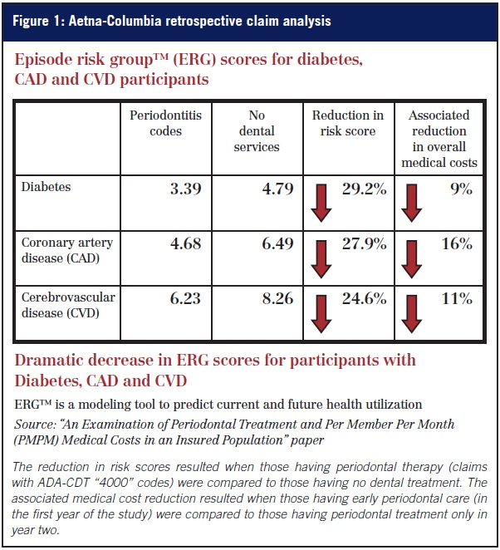
Why Oral Health?
ADA HPI: Among those newly diagnosed with type 2 diabetes periodontal intervention:
Lower total health care costs
(-$1799)
Lower total medical costs excluding pharmacy
(-$1577)
Lower total type 2 diabetes healthcare costs
(-$408)
Notes:
When talking about a shift need to explore all facets even the one’s traditionally or purposely silo’d

Slide 9
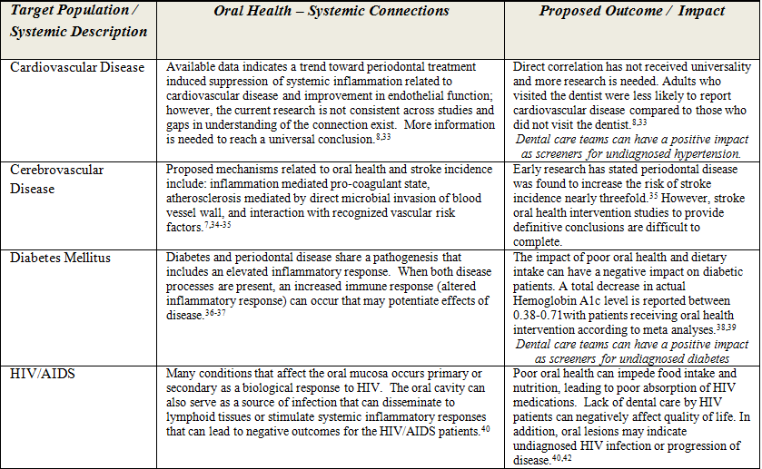
Oral Health Systemic Connection

Slide 10
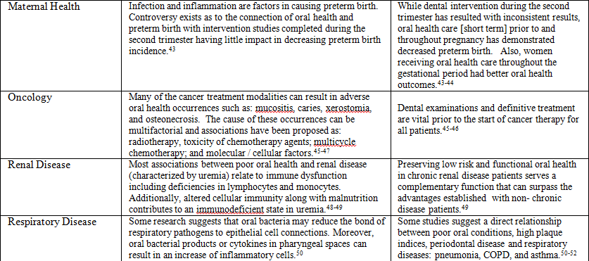
Oral Health Systemic Connection

Slide 11
DHHS Learning Action Network (LAN)
The LAN’s mission is to help achieve better care, smarter spending, and healthier people.
The Department of Health and Human Services (HHS) is working to transform the nation’s health system to emphasize value over volume.
.
William Riley, PhD, Director of the National Safety Net Advancement Center
Mark Doherty, DMD, MPH, CCHP, Executive Director Safety Net Solutions
Notes:
To achieve the goal of better care, smarter spending, and healthier people,
the U.S. health care system must substantially reform its payment structure to incentivize quality, health outcomes, and value over volume.

Slide 12
Purpose
The Health Care Payment Learning & Action Network (LAN) was launched because of the need for:
Better Care
The LAN seeks to shift our health care system from the current fee-for-service payment model to a model that pays providers and hospitals for quality care and improved health.
Smarter Spending
In order to achieve this, we need to shift our payment structure to pay for quality of care over quantity of services.
Healthier People
Such alignment requires the participation of the entire health care community.
William Riley, PhD, Director of the National Safety Net Advancement Center
Mark Doherty, DMD, MPH, CCHP, Executive Director Safety Net Solutions
Notes:
The Health Care Payment Learning & Action Network (LAN) was launched because of the need for better care, smarter spending, and healthier people.
The LAN is about shifting away from the current fee-for-service model of payment in our health care system (where more services leads to higher payments, regardless of health outcome) to one that pays providers and hospitals for quality care and improved health. In order to achieve this, payment structures need to be shifted to quality of care over quantity of services. The LAN is a collaborative network of public and private stakeholders, working together through various groups in the health care community to create awareness.

Slide 13
Goal
Adoption of Alternative Payment Models (APMs)
Goals for U.S. Health Care
2016
30%
In 2016, at least 30% of U.S. health care payments are linked to quality and value through APMs.
2018
50%
In 2018, at least 50% of U.S. health care payments are so linked.
These payment reforms are expected to demonstrate better outcomes and smarter spending for patients.
Better Care, Smarter Spending, Healthier People
William Riley, PhD, Director of the National Safety Net Advancement Center
Mark Doherty, DMD, MPH, CCHP, Executive Director Safety Net Solutions
Notes:
HHS set a goal of tying at least 30 percent of Medicare fee-for-service payments to quality or value through alternative payment models by 2016 and at least 50 percent by 2018. The LAN extends those Medicare goals to the private sector and states. As a public-private effort involving diverse stakeholders across health care, to date over 6,000 individuals are participating in the LAN.

Slide 14
APM Framework
Population-Based Accountability
At-a-Glance
Category 1 Fee for Service – No Link to Quality & Value | Category 2 Fee for Service – Link to Quality & Value | Category 3 APMs Built on Fee-for-Service Architecture | Category 4 Population-Based Payment
 | A Foundational Payments for Infrastructure & Operations B Pay for Reporting C Rewards for Performance D Rewards and Penalties for Performance | A APMs with Upside Gainsharing B APMs with Upside Gainsharing/Downside Risk | A Condition-Specific Population-Based Payment B Comprehensive Population-Based Payment
The Framework is a critical first step toward the goal of better care, smarter spending, and healthier people.
3N
Risk-based payments NOT linked to quality
4N
Capitated payments NOT linked to quality
The framework situates existing and potential APMs into a series of categories.
N
= payment models in Categories 3 and 4 that do not have a link to quality and will not count toward the APM goal.
= example payment models will not count toward APM goal.
William Riley, PhD, Director of the National Safety Net Advancement Center
Mark Doherty, DMD, MPH, CCHP, Executive Director Safety Net Solutions
Notes:
RISK THAT BUSINESSES ARE WILLING TO TAKE.
The Framework was established to: [read bullets]
Serves as the foundation for generating evidence about what works and lessons learned
Provides a road map for payment reform capable of supporting the delivery of person-centered care
Acts as a "gauge" for measuring progress toward adoption of alternative payment models
Establishes a common nomenclature and a set of conventions that will facilitate discussions within and across stakeholder communities
The framework builds on the CMS proposed framework, which includes a trajectory of categories, with Category 1, fee for service without a link to quality, being the predominant model today – and a progression to Category 4, which includes population-based payment models.
It is important when we discuss the framework to understand what the framework “is” and what it “is not.”
The framework is a MODEL for categorizing payment models
The framework is not a tool for establishing categories of delivery systems
It is also not the Work Group’s intention to determine which model is the best model to follow. The framework is meant to allow for evolution and innovation in the field while driving toward value-based payments.
Category 1: Payment models classified as Category 1 use traditional FFS payments (i.e., payments that are made for units of service) that are not adjusted to account for infrastructure investments, provider reporting of quality data, or provider performance on cost and quality metrics.
Category 2: Payment models classified as Category 2 use traditional FFS payments (i.e., payments that are made for units of service), but these payments are subsequently adjusted based on infrastructure investments to improve clinical services, providers reporting quality data, and/or providers performance on cost and quality metrics. Category 2 includes four subcategories:
Payments placed in Category 2A involve payments for infrastructure investments that can improve the quality of patient care.
Payments placed in Category 2B provide positive or negative incentives to report quality data to the health plan and (preferably) to the public.
Payments are placed in Category 2C if they provide rewards for high performance on clinical quality measures.
Payments placed in Category 2D reward providers who perform well on quality metrics and penalize providers who do not perform well, thus providing a significant linkage between payment and quality.
APMs Built on Fee-for-Service Architecture (Category 3):
Payment models classified as Category 3 are based on a FFS architecture, while providing mechanisms for the effective management of a set of procedures, an episode of care, or all health services provided for individuals.
Episode-based and other types of bundled payments encourage care coordination because they cover a complete set of related services for a procedure that may be delivered by multiple providers. Clinical episode payments fall into Category 3 if they are tied to specific procedures, such as hip replacement or back surgery. Category 3 includes two subcategories:
Category 3A gives providers an “upside” opportunity to share in the savings they generate.
Payments in Category 3B involve both upside gainsharing and downside risk based on performance on cost measures.
Population-Based Payment (Category 4):
Payment models classified as Category 4 involve population-based payments, structured in a manner that encourages providers to deliver well-coordinated, high-quality, person-level care within a defined (4A) or overall (4B) budget. Payments within Category 4 are intended to cover a wide range of preventive health, health maintenance, and health improvement services. Category 4 includes two subcategories:
Category 4A payments are population-based, but they are limited to certain sets of condition-specific services (e.g., asthma, diabetes, or cancer), but they remain person-focused in the sense that they hold providers accountable for the total cost and quality of care related to that condition.
Payments in Category 4B are capitated or population-based for all of the individual’s health care needs.

Slide 15
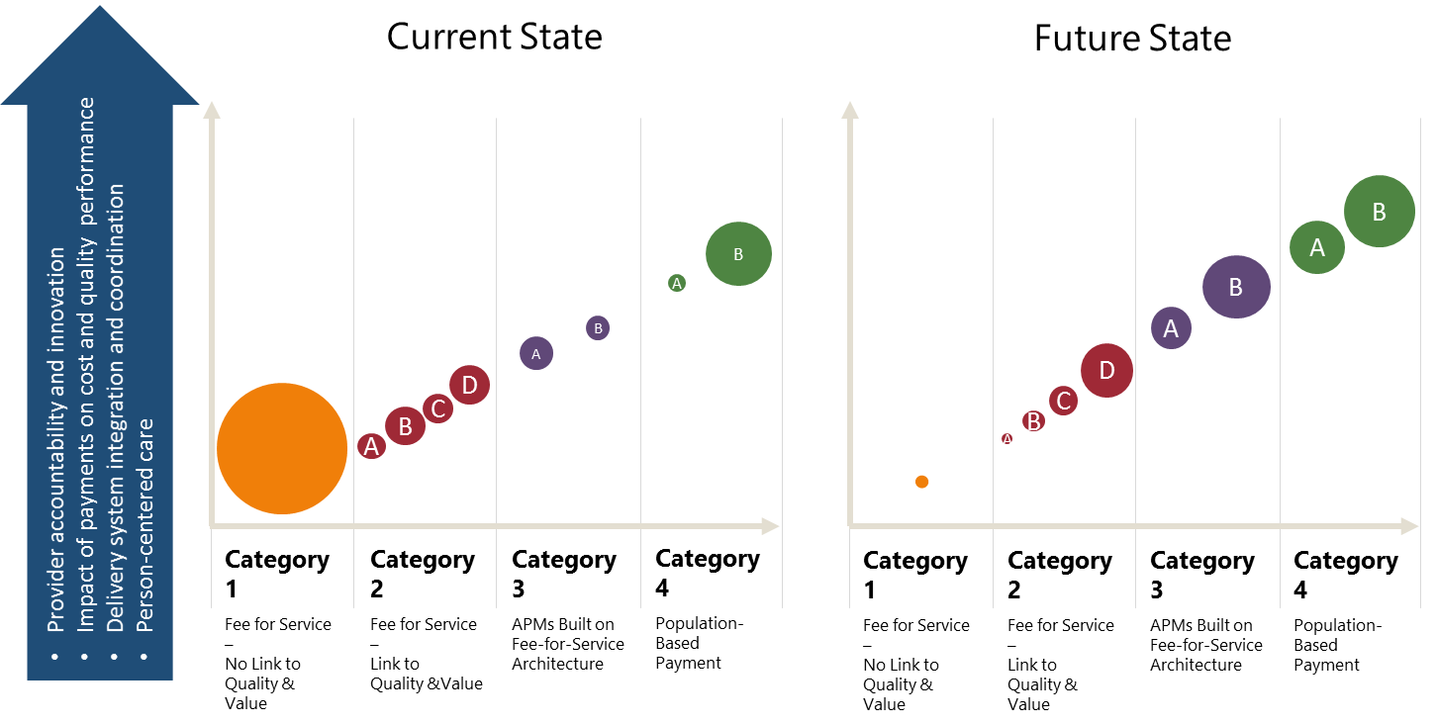
Apm Goals
For Payment Reform
Patient-centered care
William Riley, PhD, Director of the National Safety Net Advancement Center
Mark Doherty, DMD, MPH, CCHP, Executive Director Safety Net Solutions
Notes:
The overarching objective of the LAN is to encourage alignment between and within the public and private sectors as the health care system moves away from traditional FFS payment. Consistent with this objective, the Work Group recommends that, over time, public and private health plans should move concertedly toward APMs in Categories 3 and 4. The Work Group recognizes that market forces have led to different levels of delivery system organization and integration, and to differing capabilities with regard to the necessary investments in infrastructure and management to advance to more robust population health payments. Therefore, APMs in Categories 3 and 4 will not be readily achievable in every market and for every patient population, and the Work Group anticipates that some regional markets may be slower to make the transition to Categories 3 and 4.
In the figure above, the size of the various circles represents allocations (either in terms of members/beneficiaries, providers, or dollars) in various types of APMs. As the "bubble chart," as we call it, illustrates, payments shift over time from Categories 1 and 2 into Categories 3 and 4. Also, the Work Group expects that over time, APMs within a particular category will increase provider risk and innovation, make a greater impact on quality and cost performance, increase integration and coordination in delivery systems, and, ultimately, result in more patient-centered care. The figure also implies that overall spending will diminish over time. For example, compared with present Category 3B APMs, future Category 3B APMs will employ larger risk corridors and more extensive sets of quality measures; they will offer further opportunities for providers to develop innovative delivery models; and, they will provide additional support for coordinating care across multiple providers. For the reasons discussed above, the Work Group believes that these advancements will also result in more person-centered care.
Caution: Values displayed in the graphic are not precise, nor are they intended to lay out specific targets for health care reform.

Slide 16
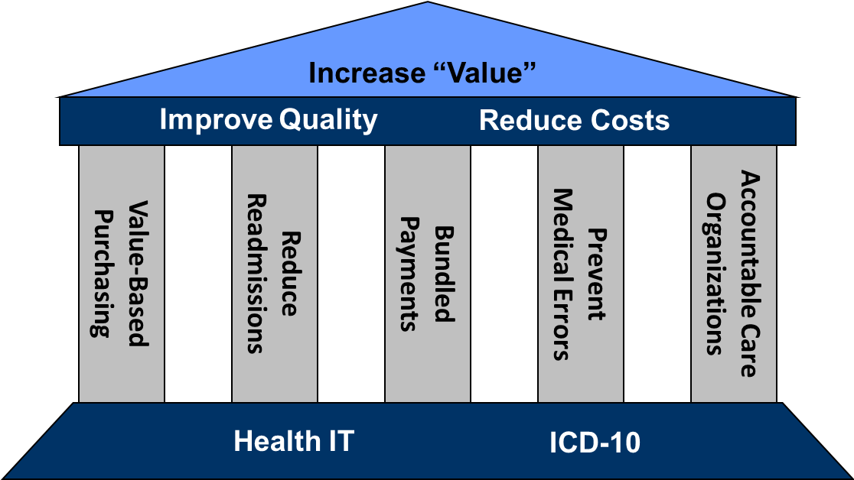
Value-Based Care
Notes:
Value over volume

Slide 17
MORE Care Overview
MEDICAL
DENTAL
Oral health evaluation
HEENOT
Risk Factor Identification
Fluoride application
Self-management goals
Dental care referral
Operational Integration of Oral Health Care
Referral acceptance verified
Clinical summaries completed for referral communication
Referral dental care completion verified
Incorporating a disease patient centered management approach to care
Cooperative Tasks
Implement a bi-directional referral system (Medical-dental referral coordination)
Initiate, develop and improve interprofessional communication protocols and processes
Identify areas of clinical and operational overlap to optimize care team time
Operational Integration of Primary Care Referral Characteristics

Slide 18
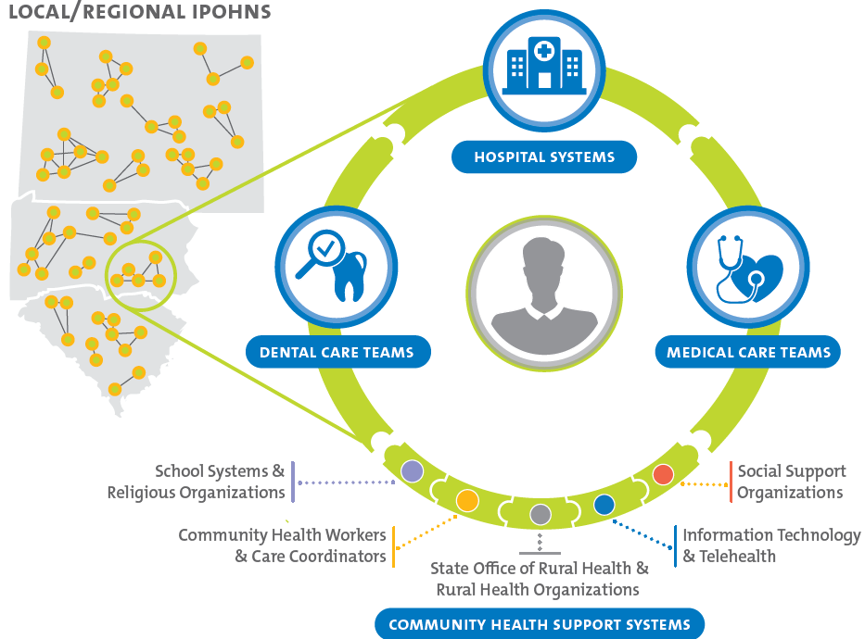

Slide 19
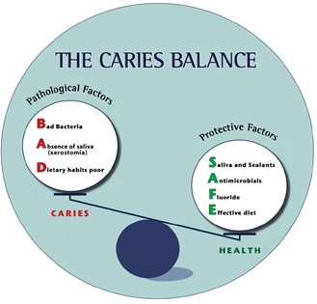
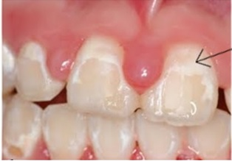
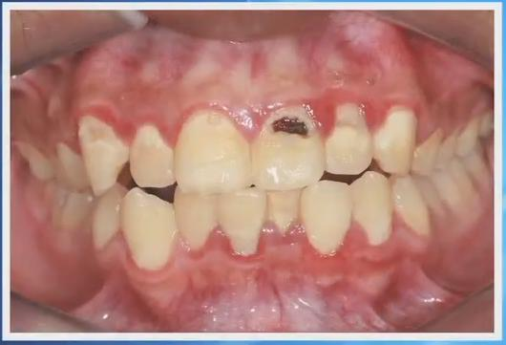
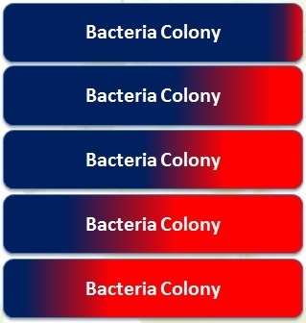
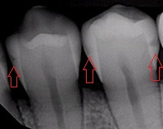
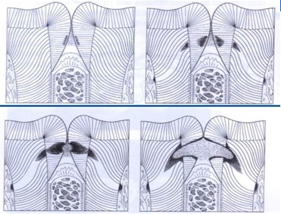
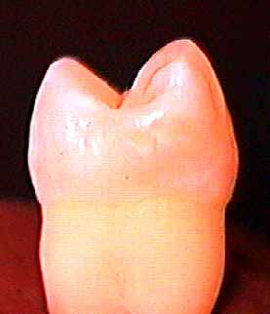
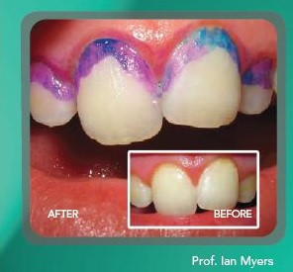
Fee for Service: the more invasive and frequent, the more profitable
Elevated Risk
“Medical Model of Care”
Early Stage
Reversible
Late Stage
Non-reversible
Cyclical Stage
“Surgical Model of Care”
Global Payment: Earlier Diagnosis and Prevention
Primary Prevention | Secondary Prevention | Tertiary Prevention
 |  | Primary Care | Specialty
Dietary counseling Behavior modification Fluoride varnish Dental sealant | Remineralization | Restorations Pulpotomy Simple endodontics Simply extractions | Endodontics Perio surgery Complex prosthodontics Oral surgery Orthodontics
Dental Assistant $17.13 Medical Assistant $14.80 Nursing Assistants $12.51 Dietetic Tech $13.74 | Dental Hygienist $34.39 Physician Assistant $45.36 Nurse Practitioner $45.71 | General Dentist $79.12 Pediatric Dentist | Oral Surgeon $105.27 Orthodontist $94.36 (not all specialists had income captured by BLS)
Early Stage
Late Stage

Slide 20
APM Framework
Population-Based Accountability
At-a-Glance
Category 1 Fee for Service – No Link to Quality & Value | Category 2 Fee for Service – Link to Quality & Value | Category 3 APMs Built on Fee-for-Service Architecture | Category 4 Population-Based Payment
 | A Foundational Payments for Infrastructure & Operations B Pay for Reporting C Rewards for Performance D Rewards and Penalties for Performance | A APMs with Upside Gainsharing B APMs with Upside Gainsharing/Downside Risk | A Condition-Specific Population-Based Payment B Comprehensive Population-Based Payment
The Framework is a critical first step toward the goal of better care, smarter spending, and healthier people.
3N
Risk-based payments NOT linked to quality
4N
Capitated payments NOT linked to quality
The framework situates existing and potential APMs into a series of categories.
N
= payment models in Categories 3 and 4 that do not have a link to quality and will not count toward the APM goal.
= example payment models will not count toward APM goal.
William Riley, PhD, Director of the National Safety Net Advancement Center
Mark Doherty, DMD, MPH, CCHP, Executive Director Safety Net Solutions
Notes:
RISK THAT BUSINESSES ARE WILLING TO TAKE.
The Framework was established to: [read bullets]
Serves as the foundation for generating evidence about what works and lessons learned
Provides a road map for payment reform capable of supporting the delivery of person-centered care
Acts as a "gauge" for measuring progress toward adoption of alternative payment models
Establishes a common nomenclature and a set of conventions that will facilitate discussions within and across stakeholder communities
The framework builds on the CMS proposed framework, which includes a trajectory of categories, with Category 1, fee for service without a link to quality, being the predominant model today – and a progression to Category 4, which includes population-based payment models.
It is important when we discuss the framework to understand what the framework “is” and what it “is not.”
The framework is a MODEL for categorizing payment models
The framework is not a tool for establishing categories of delivery systems
It is also not the Work Group’s intention to determine which model is the best model to follow. The framework is meant to allow for evolution and innovation in the field while driving toward value-based payments.
Category 1: Payment models classified as Category 1 use traditional FFS payments (i.e., payments that are made for units of service) that are not adjusted to account for infrastructure investments, provider reporting of quality data, or provider performance on cost and quality metrics.
Category 2: Payment models classified as Category 2 use traditional FFS payments (i.e., payments that are made for units of service), but these payments are subsequently adjusted based on infrastructure investments to improve clinical services, providers reporting quality data, and/or providers performance on cost and quality metrics. Category 2 includes four subcategories:
Payments placed in Category 2A involve payments for infrastructure investments that can improve the quality of patient care.
Payments placed in Category 2B provide positive or negative incentives to report quality data to the health plan and (preferably) to the public.
Payments are placed in Category 2C if they provide rewards for high performance on clinical quality measures.
Payments placed in Category 2D reward providers who perform well on quality metrics and penalize providers who do not perform well, thus providing a significant linkage between payment and quality.
APMs Built on Fee-for-Service Architecture (Category 3):
Payment models classified as Category 3 are based on a FFS architecture, while providing mechanisms for the effective management of a set of procedures, an episode of care, or all health services provided for individuals.
Episode-based and other types of bundled payments encourage care coordination because they cover a complete set of related services for a procedure that may be delivered by multiple providers. Clinical episode payments fall into Category 3 if they are tied to specific procedures, such as hip replacement or back surgery. Category 3 includes two subcategories:
Category 3A gives providers an “upside” opportunity to share in the savings they generate.
Payments in Category 3B involve both upside gainsharing and downside risk based on performance on cost measures.
Population-Based Payment (Category 4):
Payment models classified as Category 4 involve population-based payments, structured in a manner that encourages providers to deliver well-coordinated, high-quality, person-level care within a defined (4A) or overall (4B) budget. Payments within Category 4 are intended to cover a wide range of preventive health, health maintenance, and health improvement services. Category 4 includes two subcategories:
Category 4A payments are population-based, but they are limited to certain sets of condition-specific services (e.g., asthma, diabetes, or cancer), but they remain person-focused in the sense that they hold providers accountable for the total cost and quality of care related to that condition.
Payments in Category 4B are capitated or population-based for all of the individual’s health care needs.

Slide 21
Questions and Discussions

